Slide 1

WELCOME to BUFR WORLD
Introduction to BUFR decoding with ecCodes
Marijana Crepulja, Roberto Ribas
ECMWF Reading UK
Marijana.crepulja@ecmwf.int / Roberto.ribas@ecmwf.int/
BUFR
Notes:
1

Slide 2
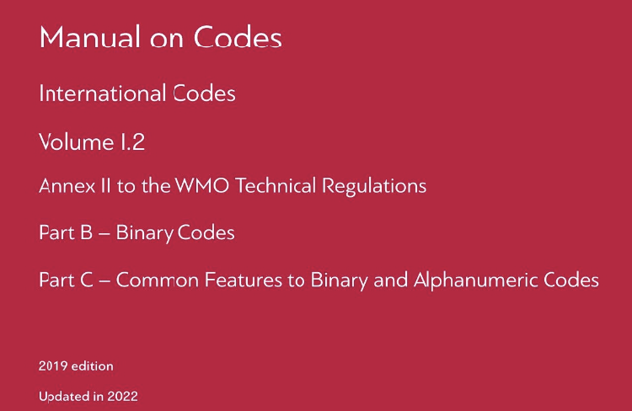
BUFR format
BUFR is a Binary Universal Format for the Representation of meteorological data. Governed by the World Meteorological Organization (WMO) through the Manual on Codes https://library.wmo.int/idurl/4/35625
BUFR is a binary format.
Mainly used for meteorological observations,
(SYNOP,TEMP, satellite data, forecast data).
2
Notes:
2

Slide 3
BUFR files and BUFR messages
BUFR files may contain one or several messages.
A BUFR message contains 6 sections:
SECTION 0 indicator section
SECTION 1 identification section
HEADERS
SECTION 2 local section (optional)
BUFR message
SECTION 3 data description section
DATA
SECTION 4 Data section
SECTION 5 contains 7777 to signal the end of the message
3

Slide 4
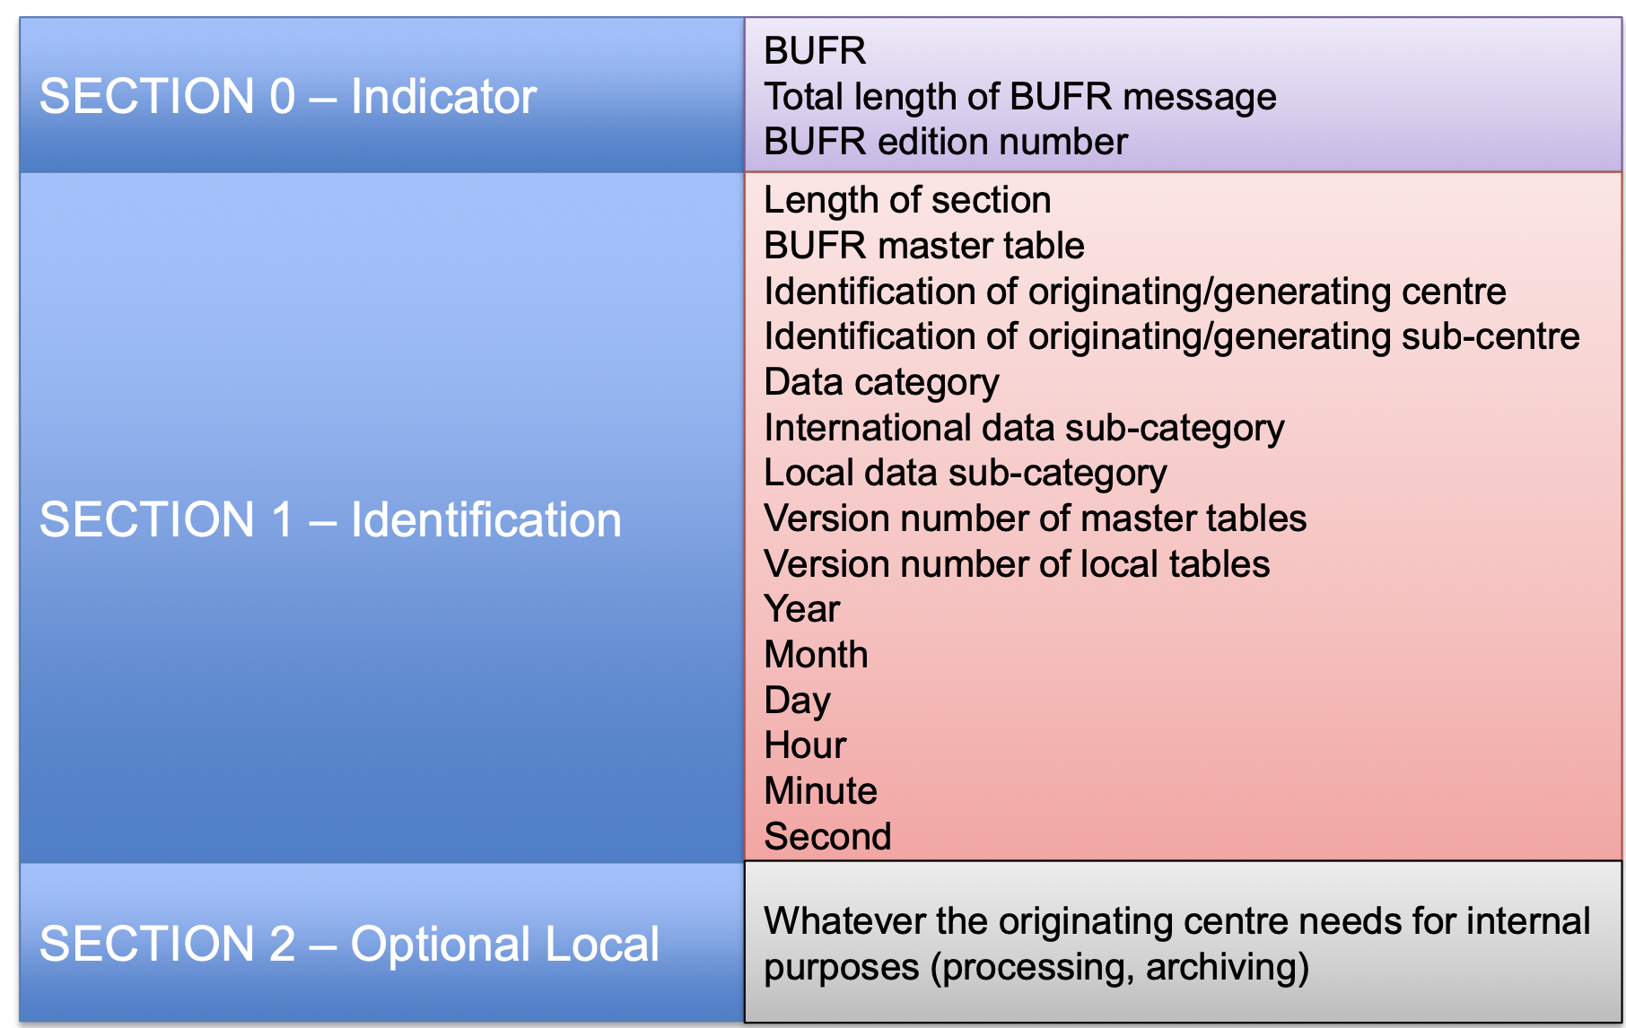
BUFR metadata (header)
4

Slide 5

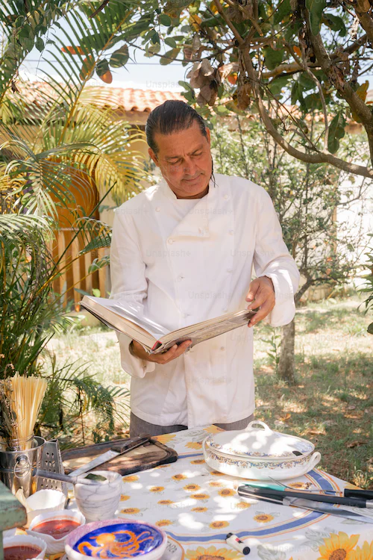

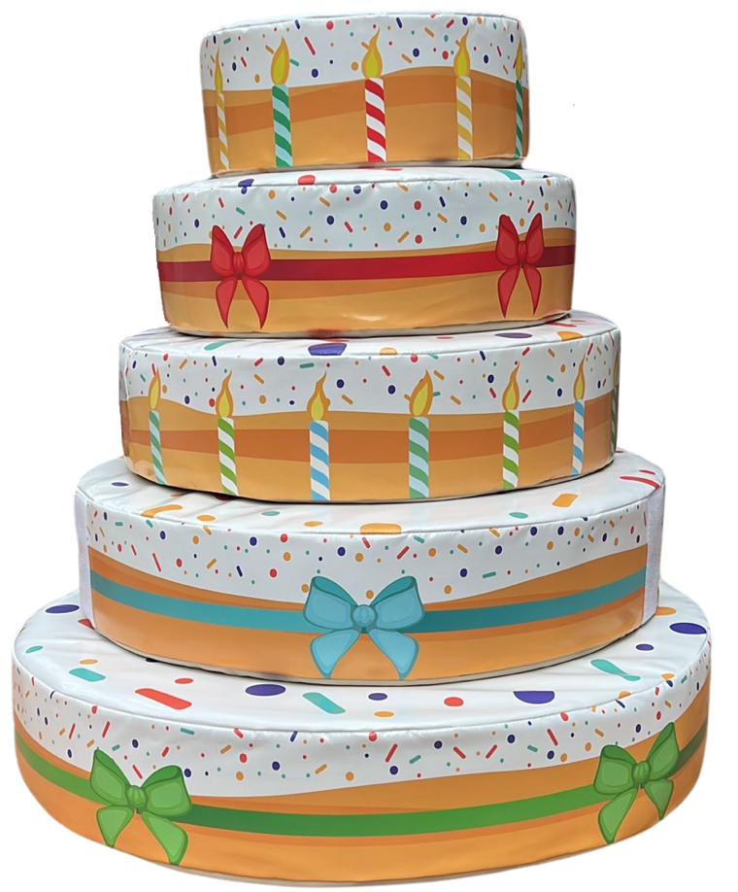
BUFR Data section (sections 3 and 4)
Contains the Data description section ( recipe) and the binary data ( ingredients).
Section 3 : Data Description Section
309007,222000,101000,031002,031031
001031,001032,101000,031002,033007
Descriptors
Binary data(bit stream)
Section 4 : Data section
1001000111000111111001000110001000100000110000100010001000100001000010000
BUFR Message
5

Slide 6
BUFR tables
To decode a BUFR message, we need to know how to parse the bit stream contained in the message. To do so, we need the WMO BUFR tables.
A bit stream is a sequence of octets ( 1 octet=8 bits).
WMO provides and updates the BUFR tables twice a year
ecCodes includes the WMO BUFR tables.
There are 4 tables
TABLE | CONTENTS
TABLE A | Data category (surface data/ Radar Data….)
TABLE B | Contains the BUFR keys ( elements)
TABLE C | Operators
TABLE D | BUFR Common Sequences (templates)
6

Slide 7
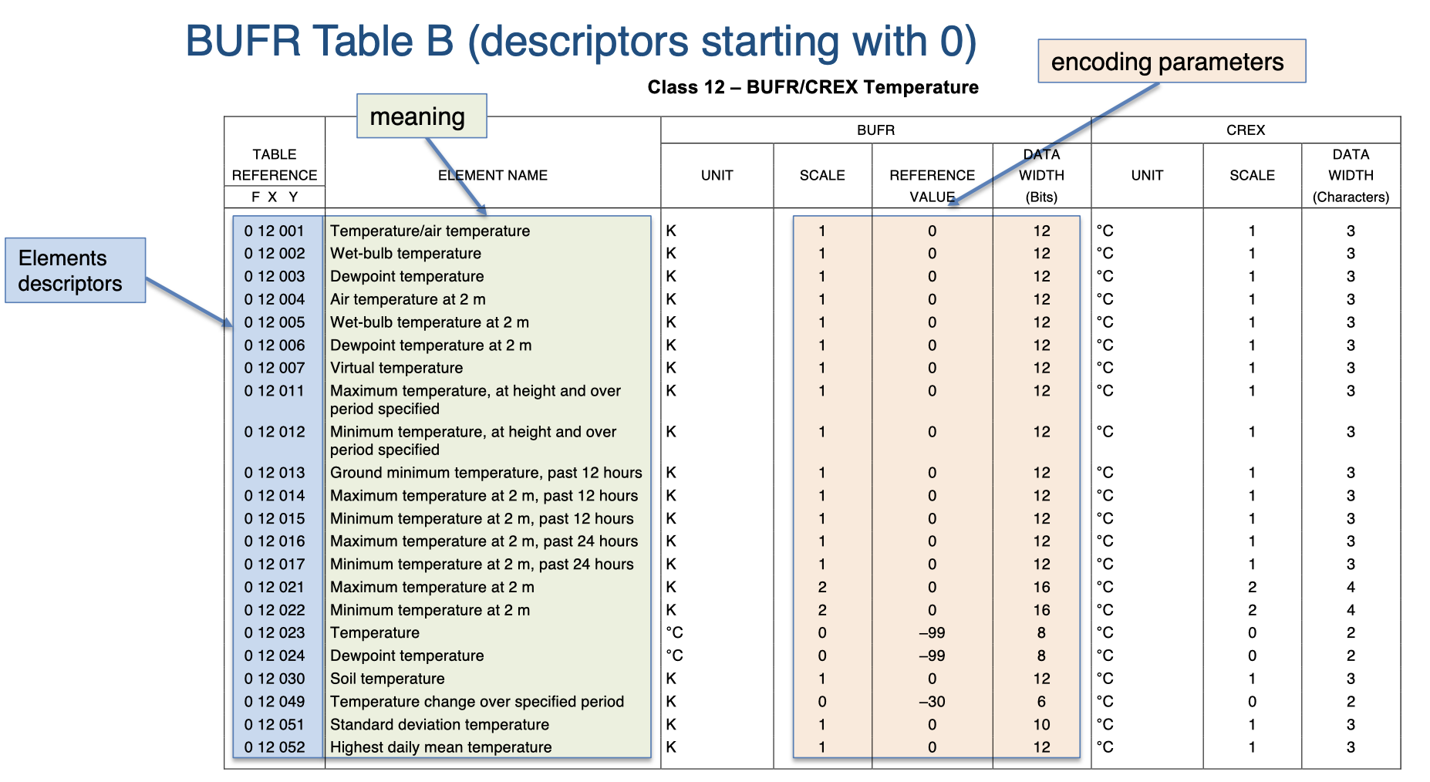
BUFR descriptors (elements) and its attributes
7

Slide 8
BUFR sequences ( templates)
F=3 indicates sequences. For example:
"301002" = [ 005001, 006001, 007001 ]
The sequence 301002 is made of three descriptors 005001, 006001 and 007001. The sequences appear in Table D(Common Sequences).
Some sequences expand to other sub sequences and contain different elements inside, including replications. It is important to know the expanded sequence when reading the BUFR message.
8

Slide 9
Resources
Videos:
https://www.youtube.com/watch?v=Xf2YuIzVS7g
https://www.youtube.com/watch?app=desktop&v=d-iiVT2XxTw
https://www.youtube.com/watch?v=xQx2214buVU
ECMWF training pages:
https://learning.ecmwf.int/mod/scorm/player.php?a=176&currentorg=Introduction_to_BUFR_decoding_with_ecCodes_ORG&scoid=452
ecCodes confluence:
https://confluence.ecmwf.int/display/ECC/ecCodes+Home
European Centre for Medium-Range Weather Forecasts
9

Slide 10
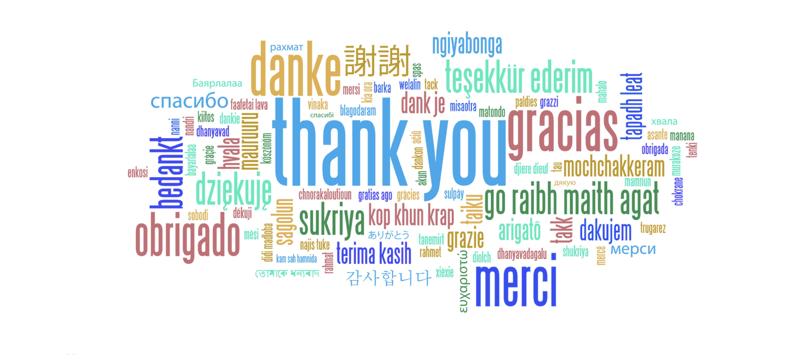
European Centre for Medium-Range Weather Forecasts
10

